Slide 1
WINE REVIEWS ANALYISIS

Slide 2
HYPOTHESIS
Hypothesis 1: Europe has higher mean price than the rest of the world
h0: Europe price mean = World price mean
ha: Europe price mean > World price mean
Hypothesis 2: Europe has higher rated wines
h0:Europe = World
ha: Europe > World
Hypothsis 3: Most of the top varietys of wines are produced in Europe
h0: Not in Europe
ha: in Europe

Slide 3
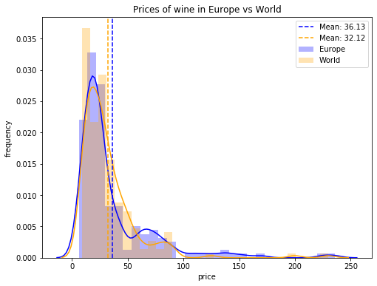
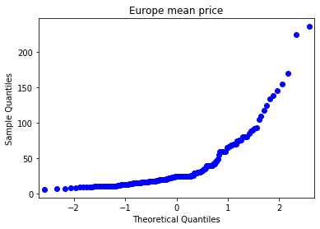
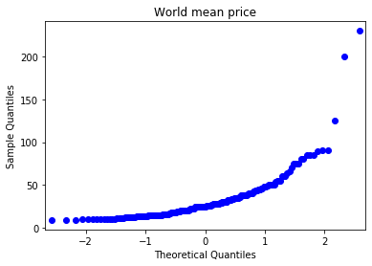
QUESTION 1 (INDEPENDENT T-TEST)
Hypothesis 1: Europe has higher mean price than the rest of the world
h0: Europe price mean = World price mean
ha: Europe price mean > World price mean
Conclusion: p value is less than 0.05 so the null hypothesis can be rejected.

Slide 4
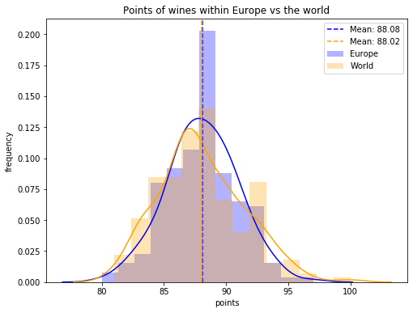

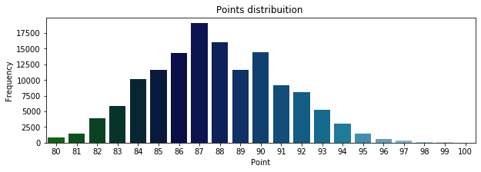
QUESTION 2 (WELCHS T-TEST)
Hypothesis 2: Europe has higher rated wines
h0:Europe = World
ha: Europe > World
Conclusion: from the results of the t-test we can reject the null hypothesis and say that Europe does have some of the best rated wines.

Slide 5
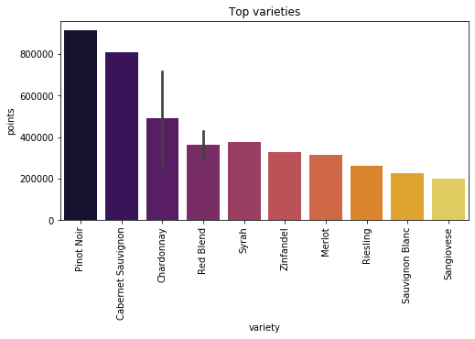
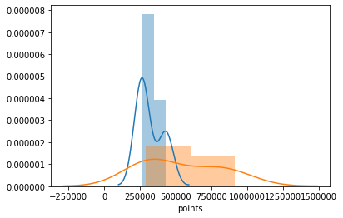

QUESTION 3 (ANOVA)
Hypothesis 3: Most of the top varieties of wines are produced in Europe
h0: Not in Europe
ha: in Europe
Conclusion: since the p values were greater than 0.5 i can accept the null hypothesis and say that the top varieties of wine are not produced in Europe despite Europe having the most expensive wines, and the highest mean in points as conducted from the previous two tests.

Slide 6
FUTURE WORK
For future work:
Review and further look into the point system, and the methods used to obtain such points for each of the wine varieties.
Look into why certain wine varieties earn better ratings in some countries but not in others.

